Slide 1
Final Project
https://github.com/marthinsurya/ID2223-Final-Project
README.md for detailed report

Slide 2
Problem/Objective
Growing LoL esport scene – Big prize pool, sponsorship
Problem: Team hires coach and analyst to improve their competitive performance. Thus, our tool is aiming to aid their work to prepare/react to various strategy outcome
What our model does? Predicts player’s choice of champion within certain team setup (variation of champions lineup from teammates & opposition)
Goal : Plan for various champions draft outcome during high stake matches

Slide 3
Structure
Util folder = functions
Scrap specific elements from page
Feature engineering
Util>data – scrapping data
Model folder = model, label encoder
1_Notebook training pipeline
2_Notebook inference

Slide 4
Training data
Scrap manually from op.gg site which gather players & trend stats
Use 3rd party site due to API issue (daily refresh)
~850 high profiles players topping leaderboard charts in their respective regions
4 regions are picked from most relevant to competitive scene supporting the tool goal
Each profiles provide various performance stats , including last ~20 matches
Train set amount to 850*20 = ~17000 rows

Slide 5
Feature engineering
Personal stats provide >150 cols
Past month/week/season performance
Mastery
Most used champions
Recent matches stats
etc
Creates 169 champions score (likelihood of being chosen by certain player in certain condition) by cross-features with
Meta trend, Personal stats
Champion stats – winrate, champions lineup, etc
Playstyle, champion loyalty, role specialization

Slide 6
Feature engineering (2)
weights = {
'recent': 0.3, # Last 20 games
'weekly': 0.4, # Last 7 days
'meta': 0.2, # Only from weekly_stats
'season': 0.06, # Current season
'mastery': 0.04 # All-time mastery
}
Due to imbalance data, we chose to manually weight the stats (based on past training iteration feature importance) to aggregate features and reduce noise. We believe it will better guide the model into the direction we want

Slide 7
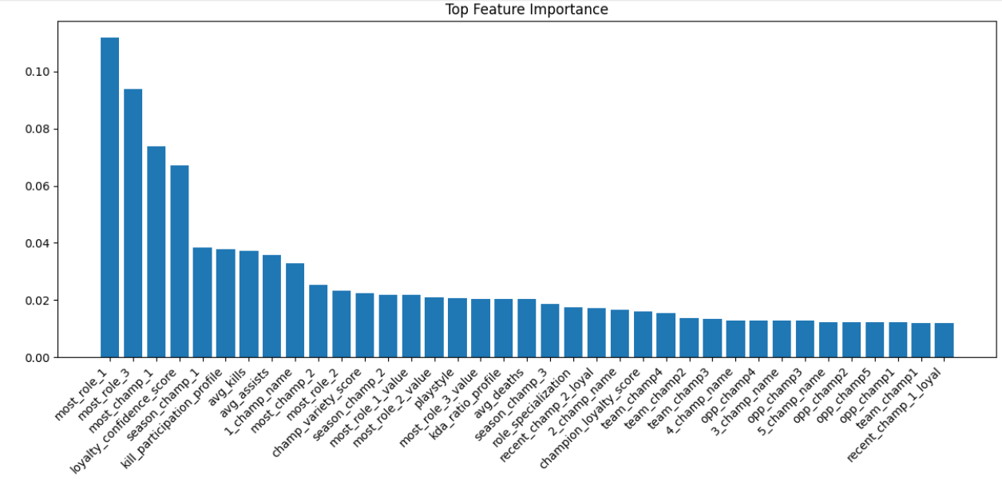
Feature engineering (3) – 36 final features
Combination of original features and cross features.

Slide 8
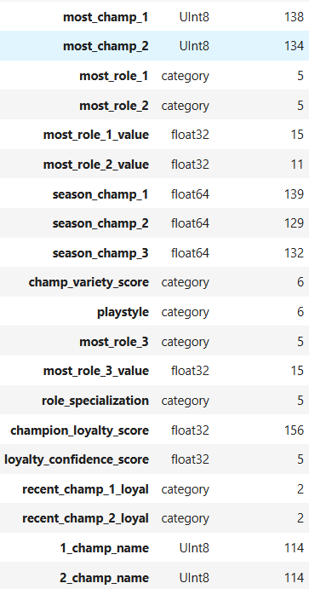
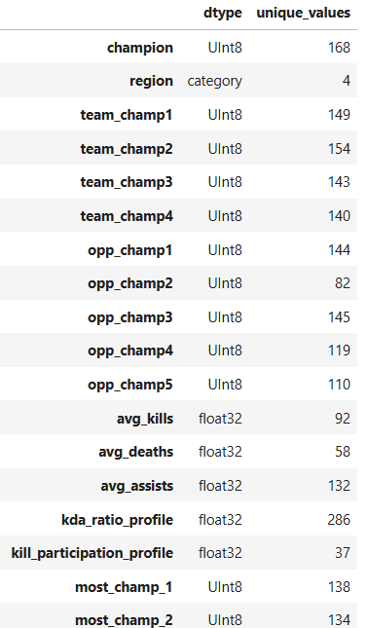
Training Features
Dtype optimization, transform features with low unique value to category type to improve training performance.

Slide 9
xgb_classifier = XGBClassifier( # Tree parameters max_depth=6, n_estimators=1000, min_child_weight=5, gamma=0.5, # Sampling parameters subsample=0.9, colsample_bytree=0.9, # Learning parameters learning_rate=0.01,
# Regularization
reg_alpha=0.8,
reg_lambda=1.8,
# Categorical handling enable_categorical=True, max_cat_to_onehot=10, max_cat_threshold=100,
# Multi-class specific num_class=len(np.unique(y_train)), objective='multi:softprob',
# Training control early_stopping_rounds=300, eval_metric='merror', random_state=42)

Slide 10
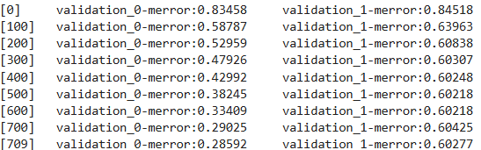
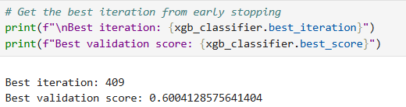
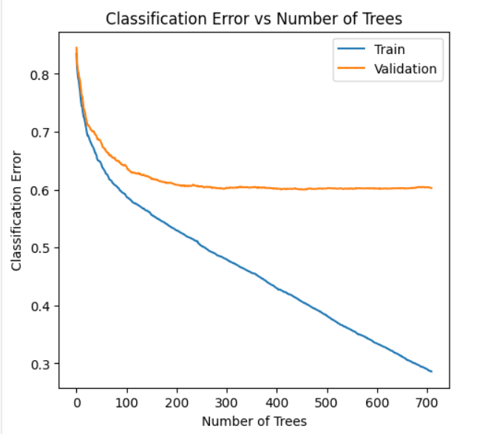

Slide 11
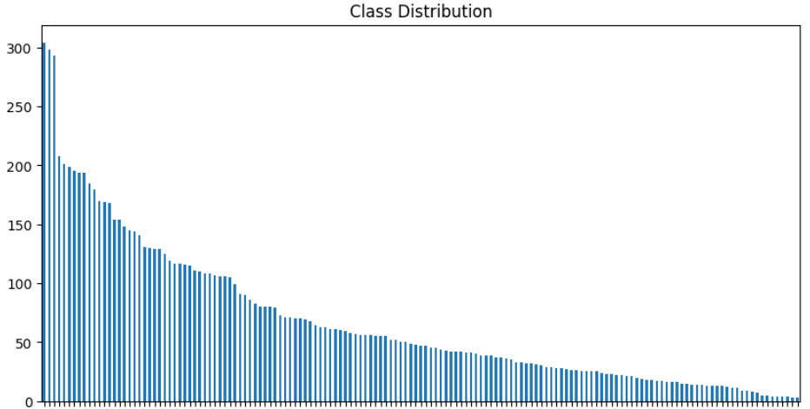


Result
Imbalanced dataset due to players’ tendency to follow meta trends, clearly visible in the long-tail distribution pattern of champion selections

Slide 12
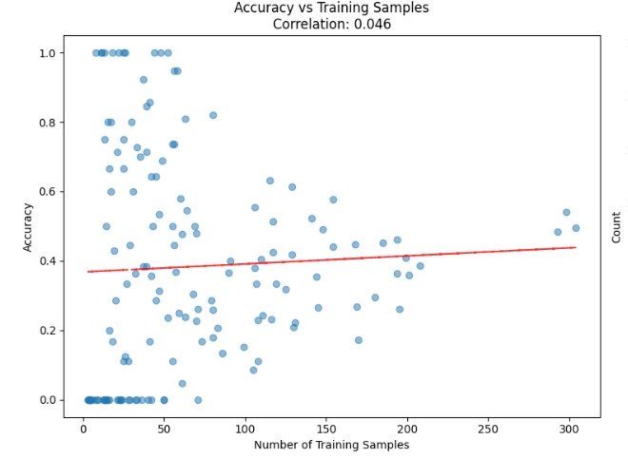
Future Improvements
Some champions had fewer than five samples, but this did not significantly affect the accuracy, as evidenced by the low correlation (0.046) between sample size and accuracy
However it shows that there IS improvement with more training samples. Thus, we concluded that low number samples affect is likely to affect the accuracy.

Slide 13
Future Improvements (2)
We believe further feature engineering of most important features will help in guiding the model better

Slide 14
Demo
Demo Time

